Slide 1
HR ANALYTICS DASHBOARD
Employee Workforce Analysis using Power BI
Project Presentation
Analysis of workforce size, demographics, hiring trends and department distribution
Tool Used: Microsoft Power BI
Prepared by: Aragonda Pavankumar

Slide 2
1. Project Objective
Analyze the overall employee workforce and key HR metrics.
Understand the distribution of remote and headquarters employees.
Study employee hiring trends over time.
Analyze workforce demographics by gender, state and race.
Identify departments with the highest employee concentration.
Generate insights to support workforce planning and HR decision-making.

Slide 3
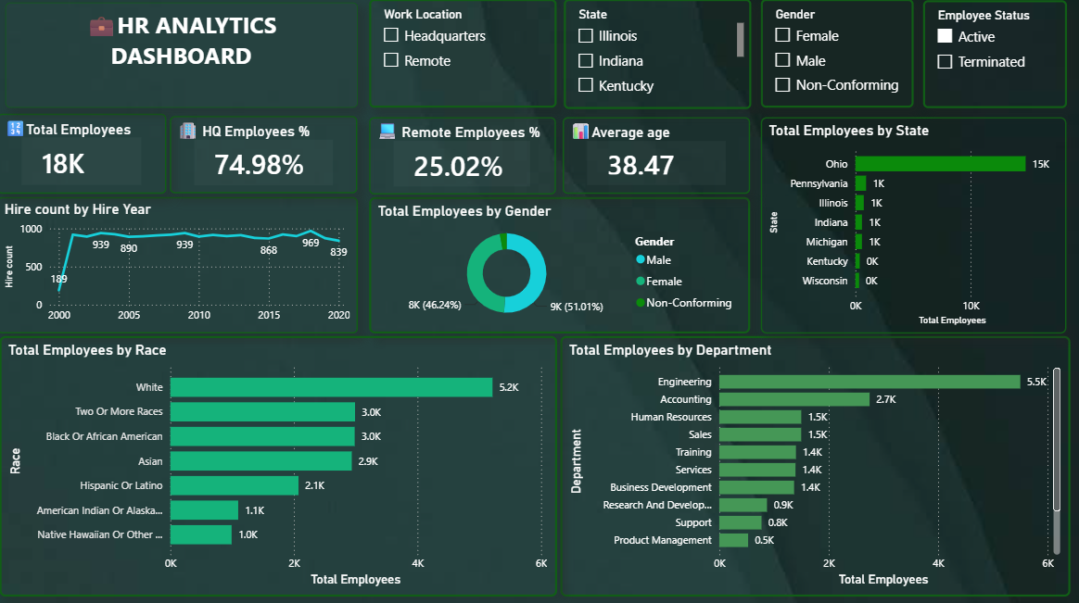
2. HR Dashboard Overview
The dashboard combines KPI cards, interactive filters and workforce distribution charts in a single Power BI report.

Slide 4
3. Workforce KPI Analysis
Total Employees
18k
Remote Employees
25.02%
HQ Employees
74.98%
Average Age
38.47 Years
• The organization has approximately 18000 employees.
• The workforce is primarily based at headquarters (74.98%).
• Remote employees account for 25.02% of the workforce.
• The average employee age is 38.47 years, indicating a mature and experienced workforce profile.

Slide 5
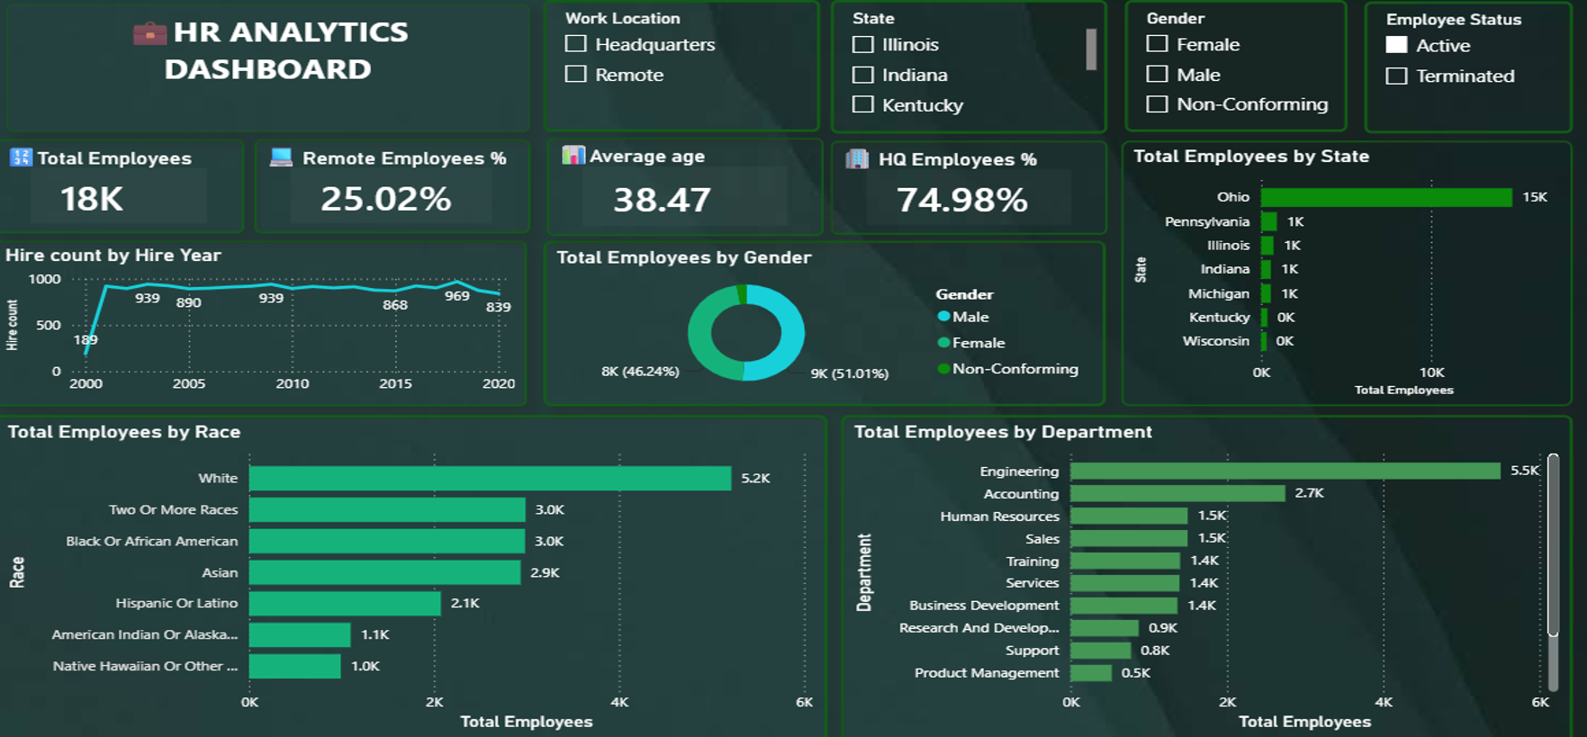
4. Employee Hiring Trend by Year
• Initial Rapid Growth (2000–2001): Recruitment surged from 189 hires in
2000 to over 900 hires per year starting in 2001.
• Consistent Hiring Baseline (2001–2020): Annual recruitment remained
remained highly stable over two decades, fluctuating within a predictable
range of 830 to 970 hires.
• Peak & Decline (2018–2020): Hiring reached a peak of 969 hires in 2018
before dropping by 13.4% to 839 hires in 2020

Slide 6
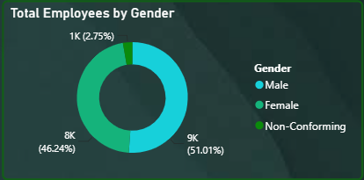
5. Employee Gender Distribution
The gender distribution is nearly balanced.
• The dashboard shows approximately 8K female employees
(46.24%).
• Approximately 9k male employees (51.01%) are shown.
• A small remaining share is represented by the non-
conforming category.
• Overall, the dashboard indicates a relatively diverse
workforce.

Slide 7
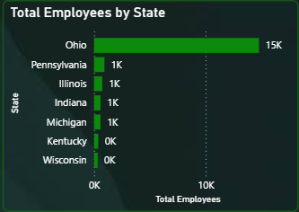
6. Employee Distribution by State
• Ohio has the highest employee concentration, with approximately 15K employees displayed.
• Pennsylvania, Illinois, Indiana and Michigan have much smaller employee counts.
• The workforce is therefore highly concentrated in one major state.
• Geographical concentration should be considered in workforce continuity and location planning.

Slide 8
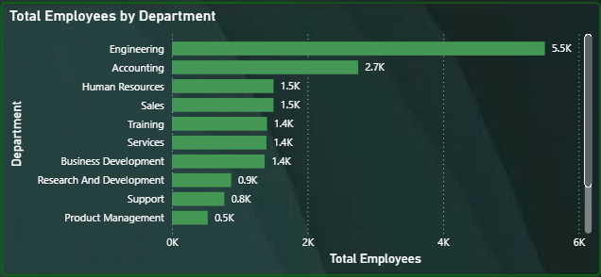
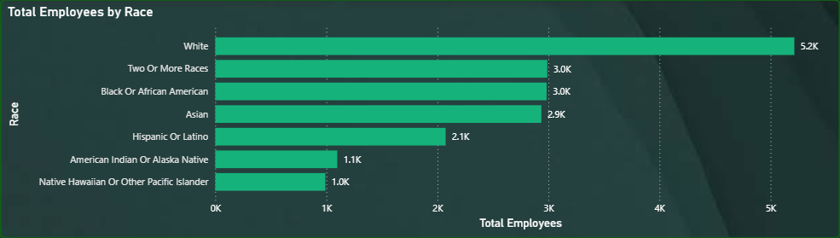
7. Workforce Distribution by Race and Department
Race: White employees form the largest group at approximately 5.2K, followed by Black/African and Asian employee groups.
Department: Engineering is the largest department at approximately 5.5K employees.
Accounting is the second-largest department at approximately 2.7K employees.
These distributions help identify workforce concentration and support diversity and staffing analysis.

Slide 9
8. Key Insights and Recommendations
• Insight: The workforce is heavily concentrated at headquarters rather than remote locations.
• Insight: Ohio and Engineering represent the strongest geographical and departmental concentrations.
• Insight: Hiring has remained relatively consistent after the early growth period.
• Recommendation: Expand remote or hybrid workforce analysis to understand opportunities for flexible work.
• Recommendation: Review workforce concentration by location to reduce dependency on a single major region.
• Recommendation: Monitor diversity metrics and department-level staffing for balanced workforce planning.

Slide 10
9. Conclusion
The HR Analytics dashboard provides a consolidated view of employee demographics, work locations, hiring patterns and departmental distribution.
The analysis highlights a predominantly HQ-based workforce, an average employee age of 38.47 years, strong employee concentration in Ohio, and Engineering as the largest department.
These insights can support strategic workforce planning, recruitment, diversity monitoring and organizational resource allocation.
THANK YOU

